Slide 1
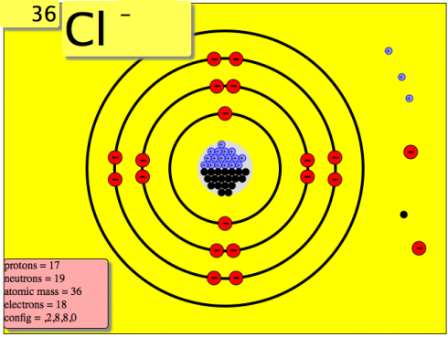
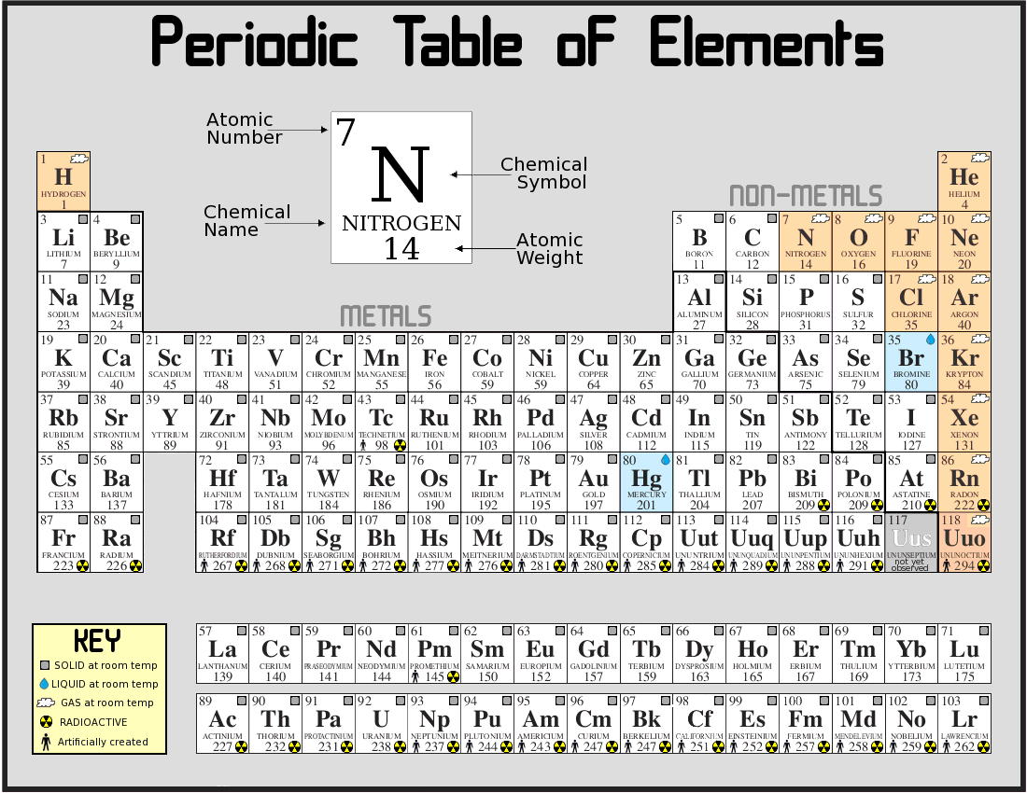
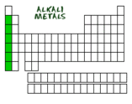
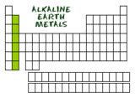
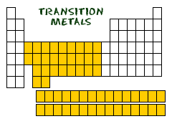
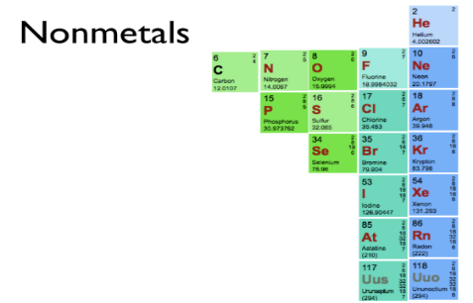
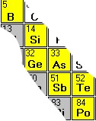
SPS1. Obtain, evaluate, and communicate information from the Periodic Table to explain the relative properties of elements based on patterns of atomic structure.
a. Develop and use models to compare and contrast the structure of atoms, ions and isotopes. (Clarification statement: Properties include atomic number, atomic mass and the location and charge of subatomic particles.)
b. Analyze and interpret data to determine trends of the following:
•Number of valence electrons
•Types of ions formed by main group elements
•Location and properties of metals, nonmetals, and metalloids
•Phases at room temperature
c. Use the Periodic Table as a model to predict the above properties of main group elements.

Slide 2
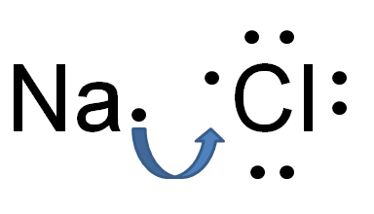
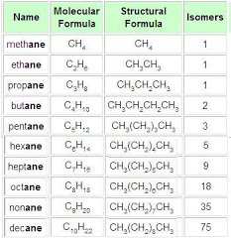
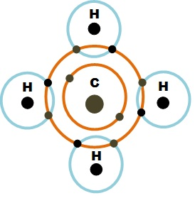
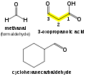
SPS2. Obtain, evaluate, and communicate information to explain how atoms bond to form stable compounds.
a. Analyze and interpret data to predict properties of ionic and covalent compounds. (Clarification statement: Properties are limited to types of bonds formed, elemental composition, melting point, boiling point, and conductivity.)
b. Develop and use models to predict formulas for stable, binary ionic compounds based on balance of charges.
c. Use the International Union of Pure and Applied Chemistry (IUPAC) nomenclature for translating between chemical names and chemical formulas. (Clarification statement: Limited to binary covalent and binary ionic, containing main group elements, compounds but excludes polyatomic ions.)

Slide 3
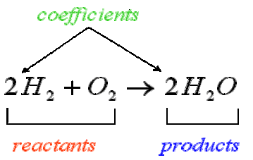
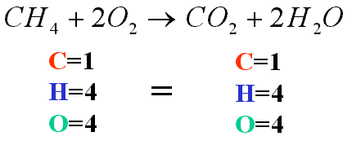
SPS3. Obtain, evaluate, and communicate information to support the Law of Conservation of Matter.
a. Plan and carry out investigations to generate evidence supporting the claim that mass is conserved during a chemical reaction. (Clarification statement: Limited to synthesis, decomposition, single replacement, and double replacement reactions.)
b. Develop and use a model of a chemical equation to illustrate how the total number of atoms is conserved during a chemical reaction.
(Clarification statement: Limited to chemical equations that include binary ionic and covalent compounds and will not include equations containing polyatomic ions.)

Slide 4
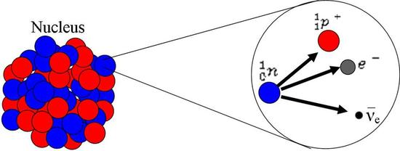
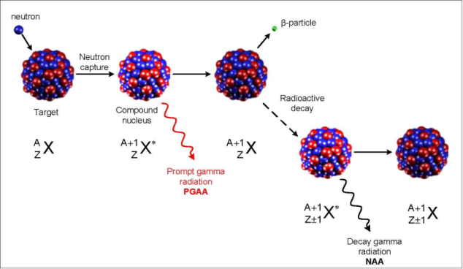
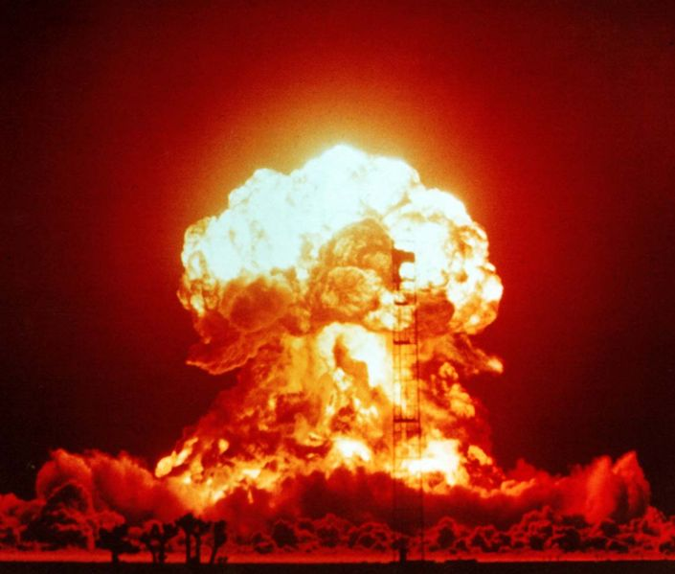
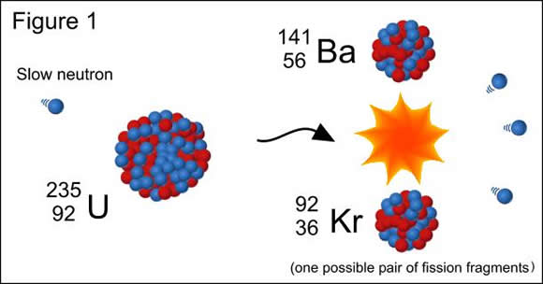
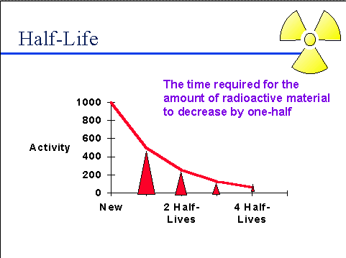
SPS4. Obtain, evaluate, and communicate information to explain the changes in nuclear structure as a result of fission, fusion and radioactive decay.
Develop a model that illustrates how the nucleus changes as a result of fission and fusion.
b. Use mathematics and computational thinking to explain the process of half-life as it relates to radioactive decay. (Clarification statement: Limited to calculations that include whole half-lives.)
c. Construct arguments based on evidence about the applications, benefits, and problems of nuclear energy as an alternative energy source.

Slide 5
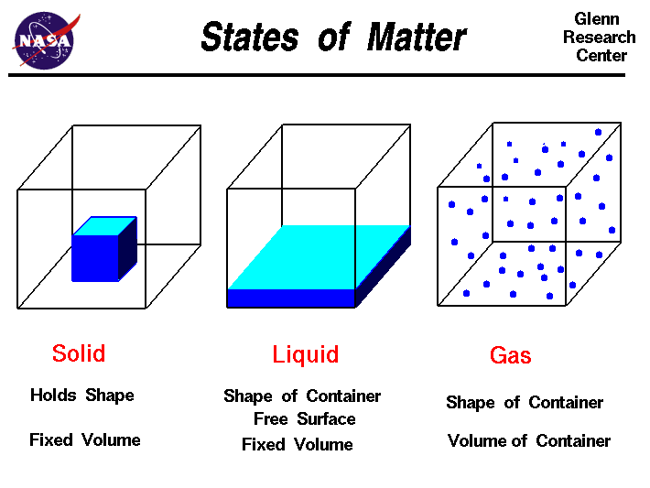
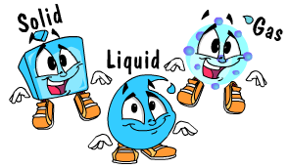
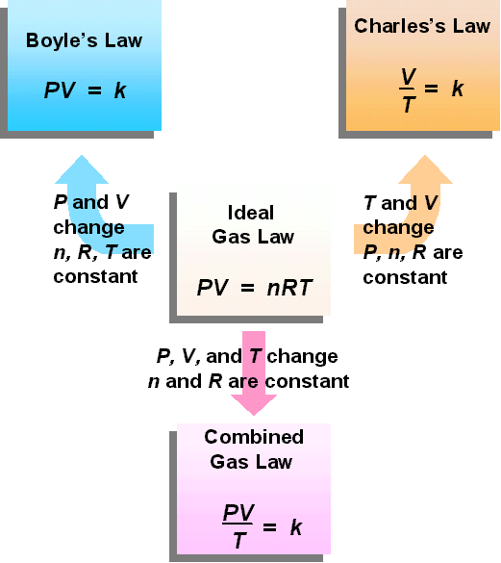
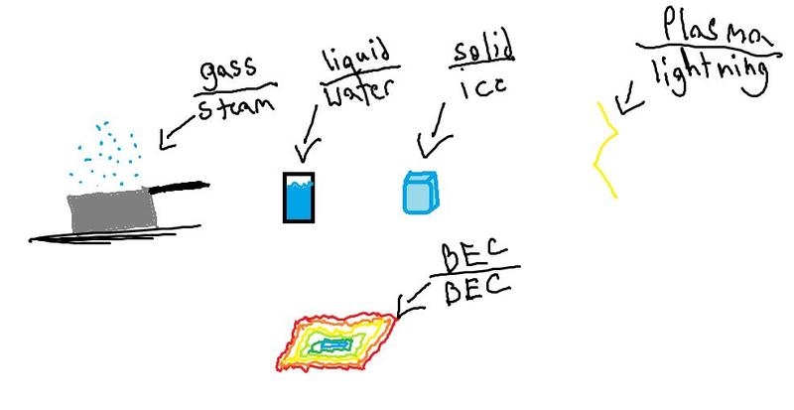
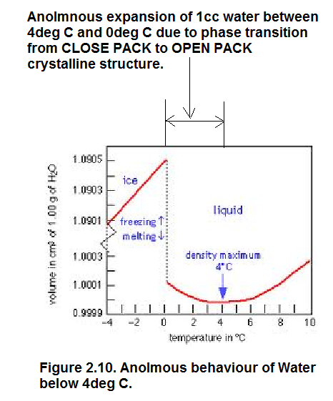
SPS5. Obtain, evaluate, and communicate information to compare and contrast the phases of matter as they relate to atomic and molecular motion.
a. Ask questions to compare and contrast models depicting the particle arrangement and motion in solids, liquids, gases, and plasmas.
b. Plan and carry out investigations to identify the relationships among temperature, pressure, volume, and density of gases in closed systems. (Clarification statement: Using specific Gas laws to perform calculations is beyond the scope of this standard; emphasis should focus on the conceptual understanding of the behavior of
gases rather than calculations.)

Slide 6
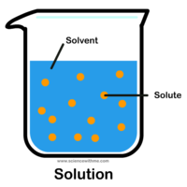
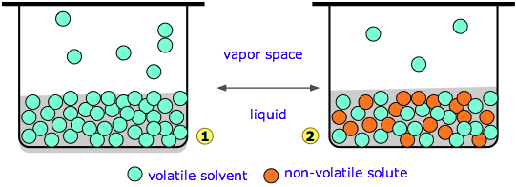
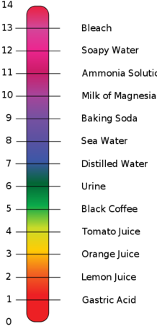
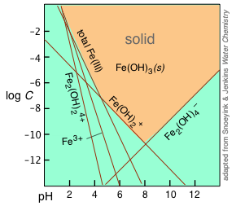
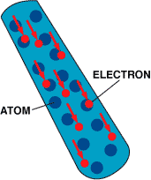
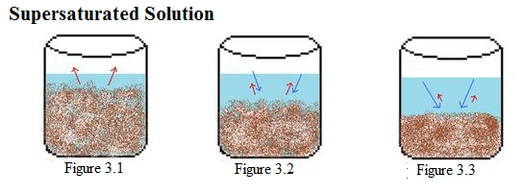
SPS6. Obtain, evaluate, and communicate information to explain the properties of solutions.
a. Develop and use models to explain the properties (solute/solvent, conductivity, and concentration) of solutions.
b. Plan and carry out investigations to determine how temperature, surface area, and agitation affect the rate solutes dissolve in a specific solvent.
c. Analyze and interpret data from a solubility curve to determine the effect of temperature on solubility.
d. Obtain and communicate information to explain the relationship between the structure and properties (e.g., pH, and color change in the presence of an indicator) of acids and bases. (Clarification statement: Limited to only the structure of simple acids and bases (e.g., HCl and NaOH) that demonstrates the presence of an H+ or OH-.)
e. Plan and carry out investigations to detect patterns in order to classify common household substances as acidic, basic, or neutral.

Slide 7
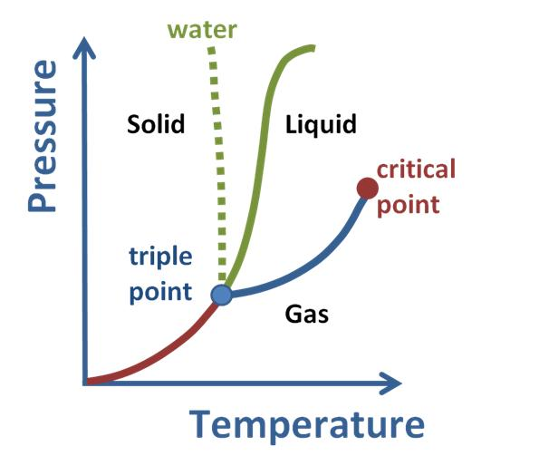
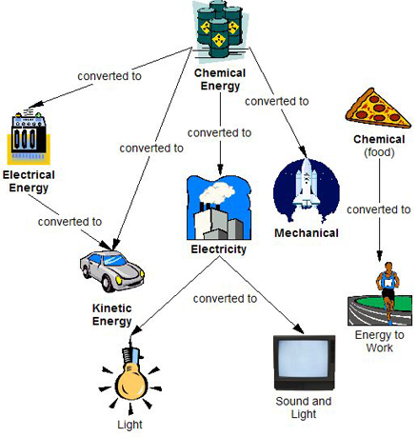
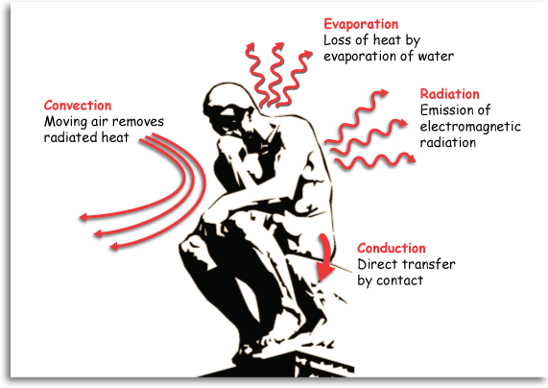
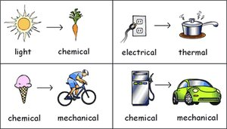
SPS7. Obtain, evaluate, and communicate information to explain transformations and flow
of energy within a system.
a. Construct explanations for energy transformations within a system. (Clarification statement: Types of energy to be addressed include chemical, mechanical, electromagnetic, light, sound, thermal, electrical, and nuclear.) b. Plan and carry out investigations to describe how molecular motion relates to thermal energy changes in terms of conduction, convection, and radiation.
c. Analyze and interpret specific heat data to justify the selection of a material for a practical application (e.g., insulators and cooking vessels).
d. Analyze and interpret data to explain the flow of energy during phase changes using heating/cooling curves.

Slide 8
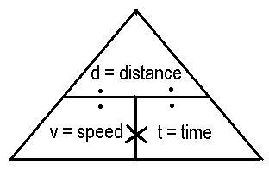
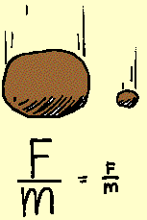
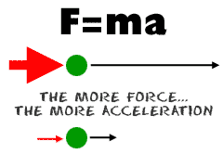
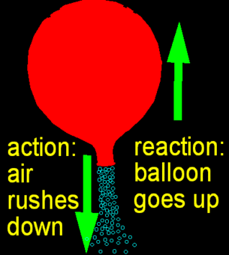
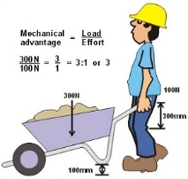
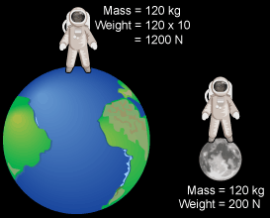
SPS8. Obtain, evaluate, and communicate information to explain the relationships among force, mass, and motion.
a. Plan and carry out an investigation to analyze the motion of an object using mathematical and graphical models.
(Clarification statement: Mathematical and graphical models could include distance, displacement, speed, velocity, time and acceleration.)
b. Construct an explanation based on experimental evidence to support the claims presented in Newton’s three laws of motion. (Clarification statement: Evidence could demonstrate relationships among force, mass, velocity, and acceleration.)
c. Analyze and interpret data to identify the relationship between mass and gravitational force for falling objects.
d. Use mathematics and computational thinking to identify the relationships between work, mechanical advantage, and simple machines.

Slide 9
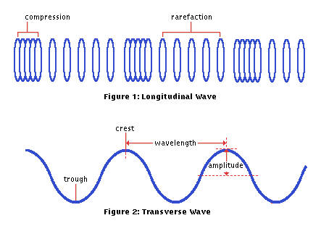
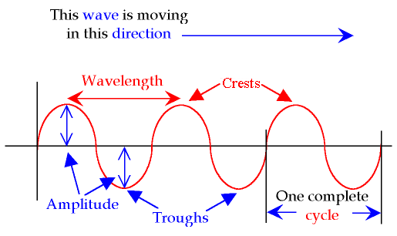
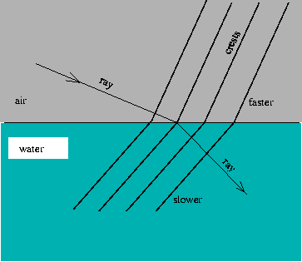
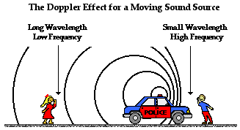
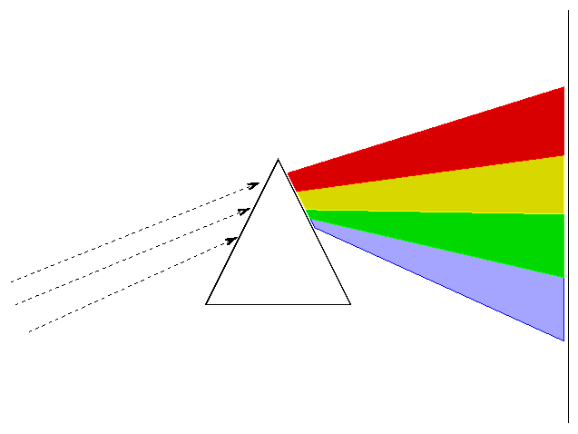
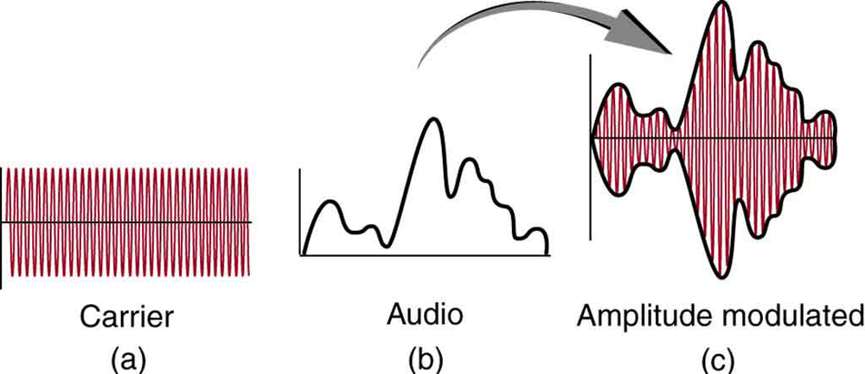
SPS9. Obtain, evaluate, and communicate information to explain the properties of waves.
a. Analyze and interpret data to identify the relationships among wavelength, frequency, and energy in electromagnetic waves and amplitude and energy in mechanical waves.
b. Ask questions to compare and contrast the characteristics of electromagnetic and mechanical waves.
c. Develop models based on experimental evidence that illustrate the phenomena of reflection, refraction, interference, and diffraction.
d. Analyze and interpret data to explain how different media affect the speed of sound and light waves.
e. Develop and use models to explain the changes in sound waves associated with the Doppler Effect.

Slide 10
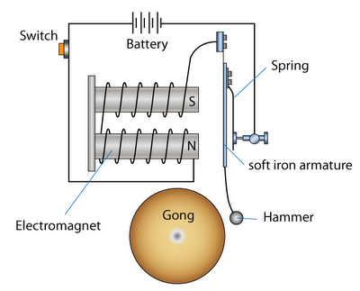
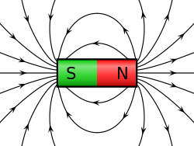
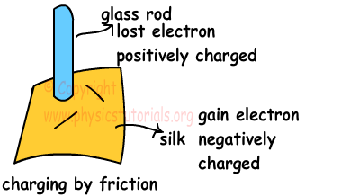
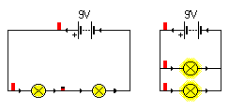
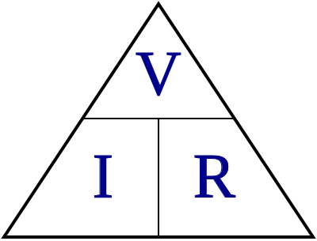
SPS10. Obtain, evaluate, and communicate information to explain the properties of and relationships between electricity and magnetism.
a. Use mathematical and computational thinking to support a claim regarding relationships among voltage, current, and resistance.
b. Develop and use models to illustrate and explain the conventional flow (direct and alternating) of current and the flow of electrons in simple series and parallel circuits. (Clarification statement: Advantages and disadvantages of series and parallel circuits should be addressed.)
c. Plan and carry out investigations to determine the relationship between magnetism and the movement of electrical charge.
(Clarification statement: Investigations could include electromagnets, simple motors, and generators.)

